Slide 1

Identification, synthesis, and development of the sex pheromone of the mealybug, Ferrisia gilli
Jocelyn Millar, Dept of Entomology, UC Riverside
Kent Daane, Environmental Science, Policy, and Management, UC Berkeley/Kearney Ag Center

Slide 2
Background:
Gill’s mealybug, Ferrisia gilli
  Increasing in importance as a pistachio pest in CA
    Direct damage through feeding, indirect via honeydew/molds
  Also infesting other crops (e.g. grapes, almonds, ornamentals)
  Expanding its range
Effective control requires careful monitoring of populations and life stages, to time control measures
Pheromone-baited traps would be useful monitoring tools

Slide 3
Pheromones for Ferrisia spp.
Our previous work: demonstrated that F. gilli does indeed have a female-produced pheromone
  Electroantennogram responses
  Attraction of males to an extract of females
Pheromone identified for Ferrisia virgata (Tabata et al. 2017)
Pheromone is a typical mealybug terpenoid ester
F. gilli pheromone is likely to have a similar structure

Slide 4
Work during 2020-2021:
Establish lab colonies at UCR in fall 2020
Collect pheromone from cohorts of virgin females on butternut squash
Try alternative rearing substrates to try and increase pheromone yield
  Grapevines
  Acorn squash
Results to date:
  Reproduced electroantennogram responses to a compound in the extracts
  So far, from ~90 extracts, still not enough material to get any meaningful structural data
    E.g., need a mass spectrum, at a minimum

Slide 5
Testing mealybugs on different types of squash/pumpkins

Slide 6
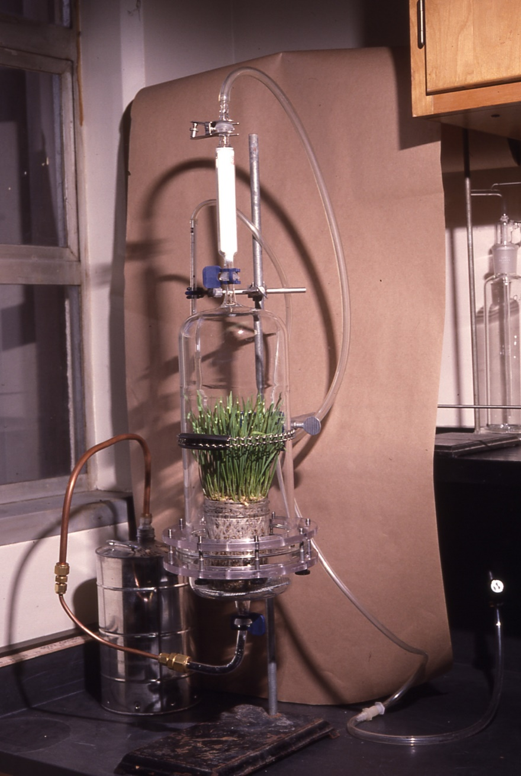
Apparatus for collecting volatiles from live plants

Slide 7
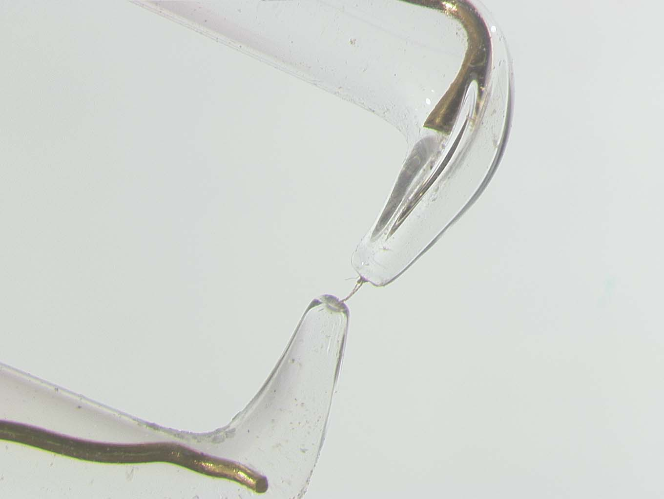
Antennal preparation for GC-EAD. Gold wire is 1 mm in diameter
Head/antennae of
male mealybug

Slide 8
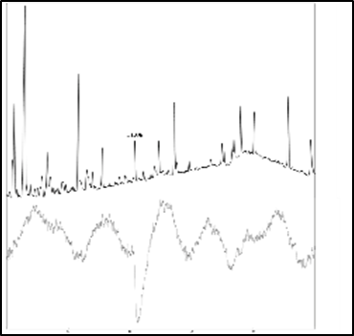
Coupled gas chromatography-electroantennogram analysis of an extract
GC trace
Antennal response

Slide 9
Project goal:
Identify, synthesize, develop applications for F. gilli pheromone

Slide 10
2022 Objectives:
Bottom line: we need enough pheromone to get spectra for its identification
Collect pheromone from mealybugs on squash/pumpkins, grapevines.
Try alternative rearing substrates (e.g., potato sprouts)
Try alternative pheromone collection/analysis methods (Solid phase microextraction)

Slide 11
Thanks for your support!
Questions?

